Slide 1


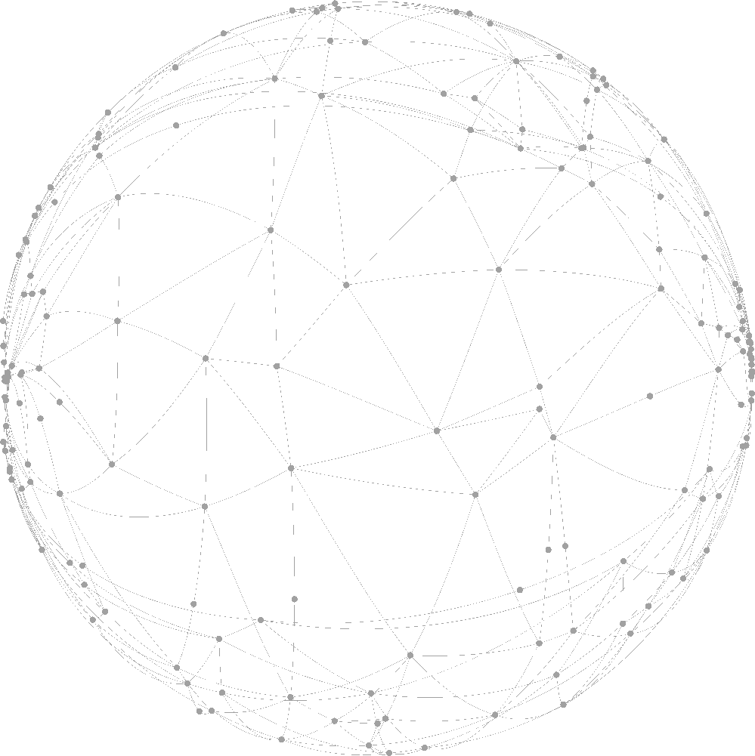

Predictive Model for
Credit Risk
Team 11

Slide 2
01
Data Cleaning
CONTENT
02
Predictive Model
content
03
Interactive Interface
04
Recommendation

Slide 3
1
Data Cleaning

Slide 4
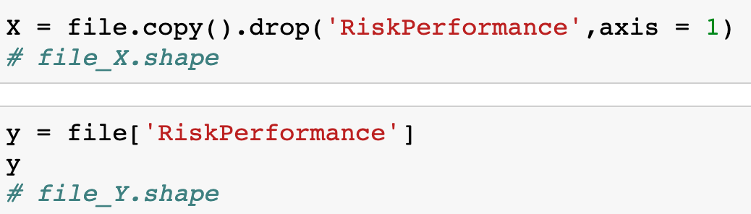

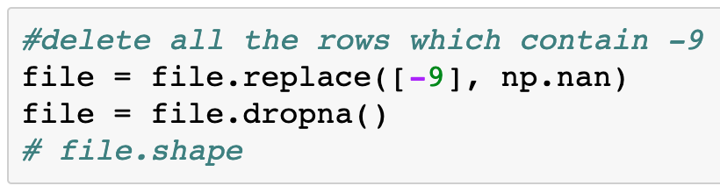
1.Special Values
2. Separate dataset with feature and target list
-9 : Replace with NA and drop all rows
-8 : keep in raw data
-7 : keep in raw data

Slide 5
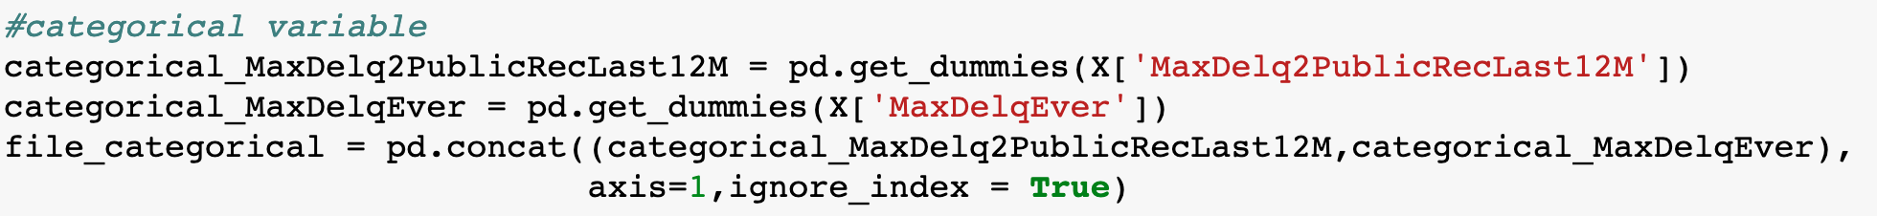
3. Reconstruct Categorical Variables

Slide 6
2
Predictive Model

Slide 7


Model Using
GaussianNB
DecisionTree
RandomForest
AdaBoost
KNN
SVM
LogisticRegression
Model Evaluation
Accuracy
CV Score
RMSE
Precision
Recall

Slide 8
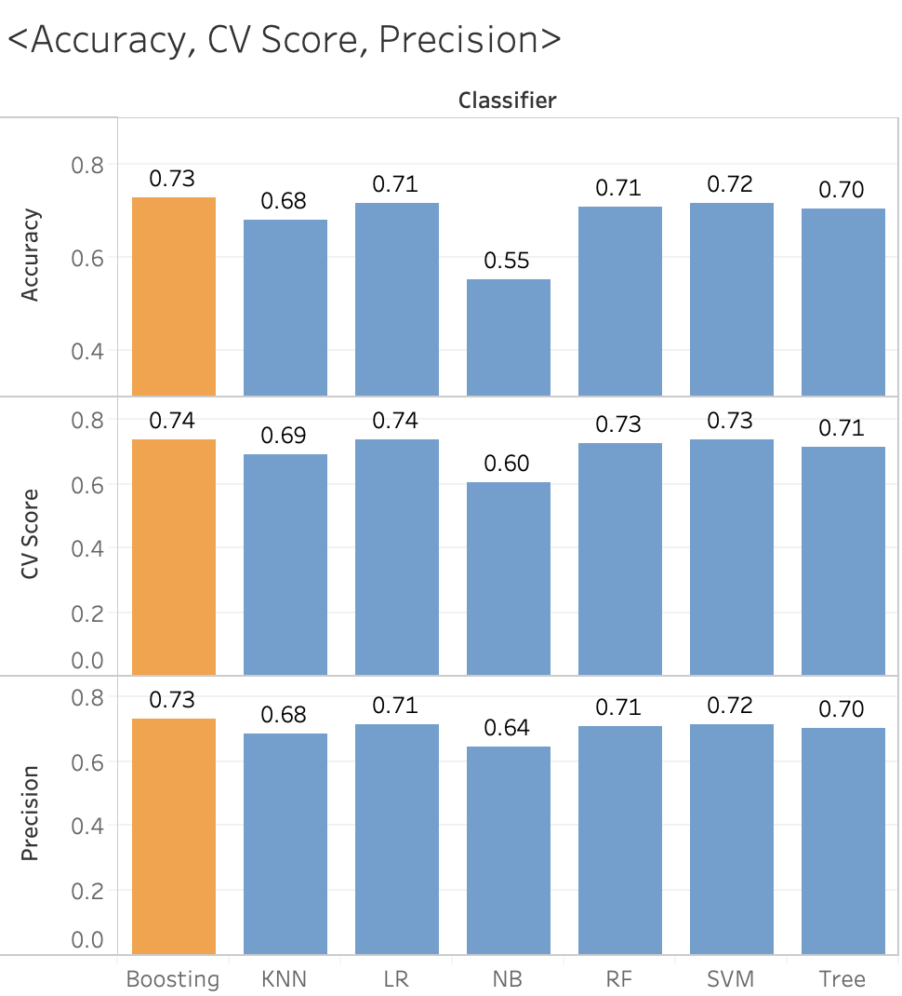
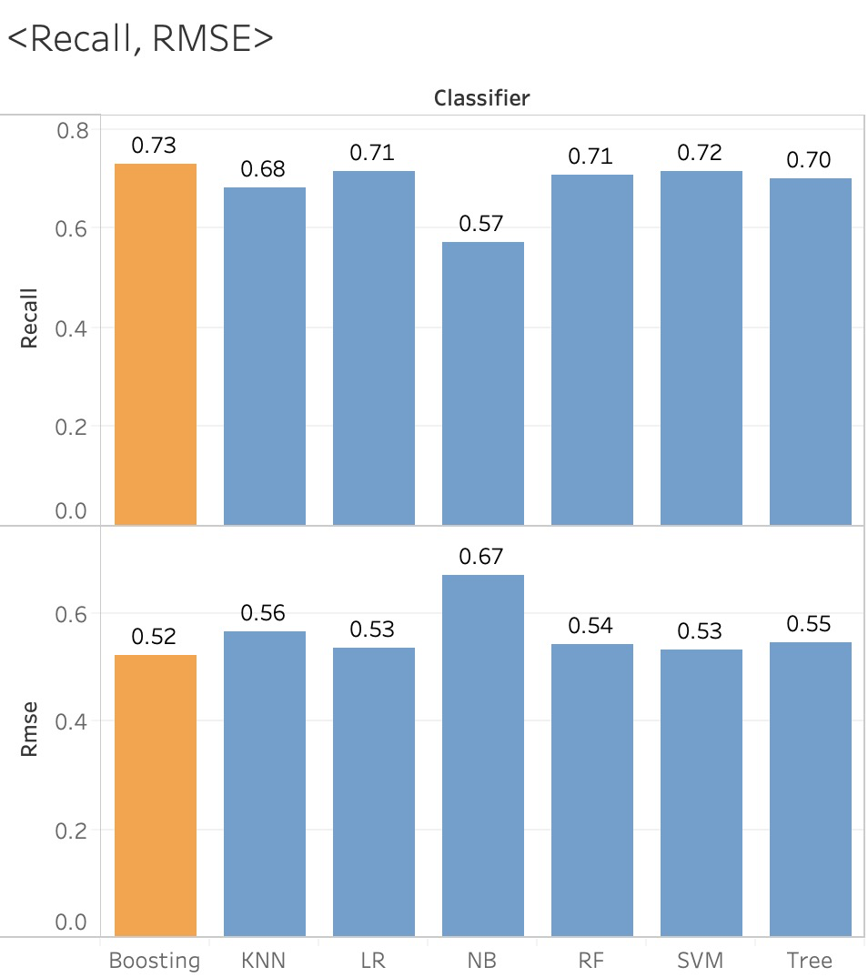
Model Performance and Comparison

Slide 9
3
Interactive Interface

Slide 10
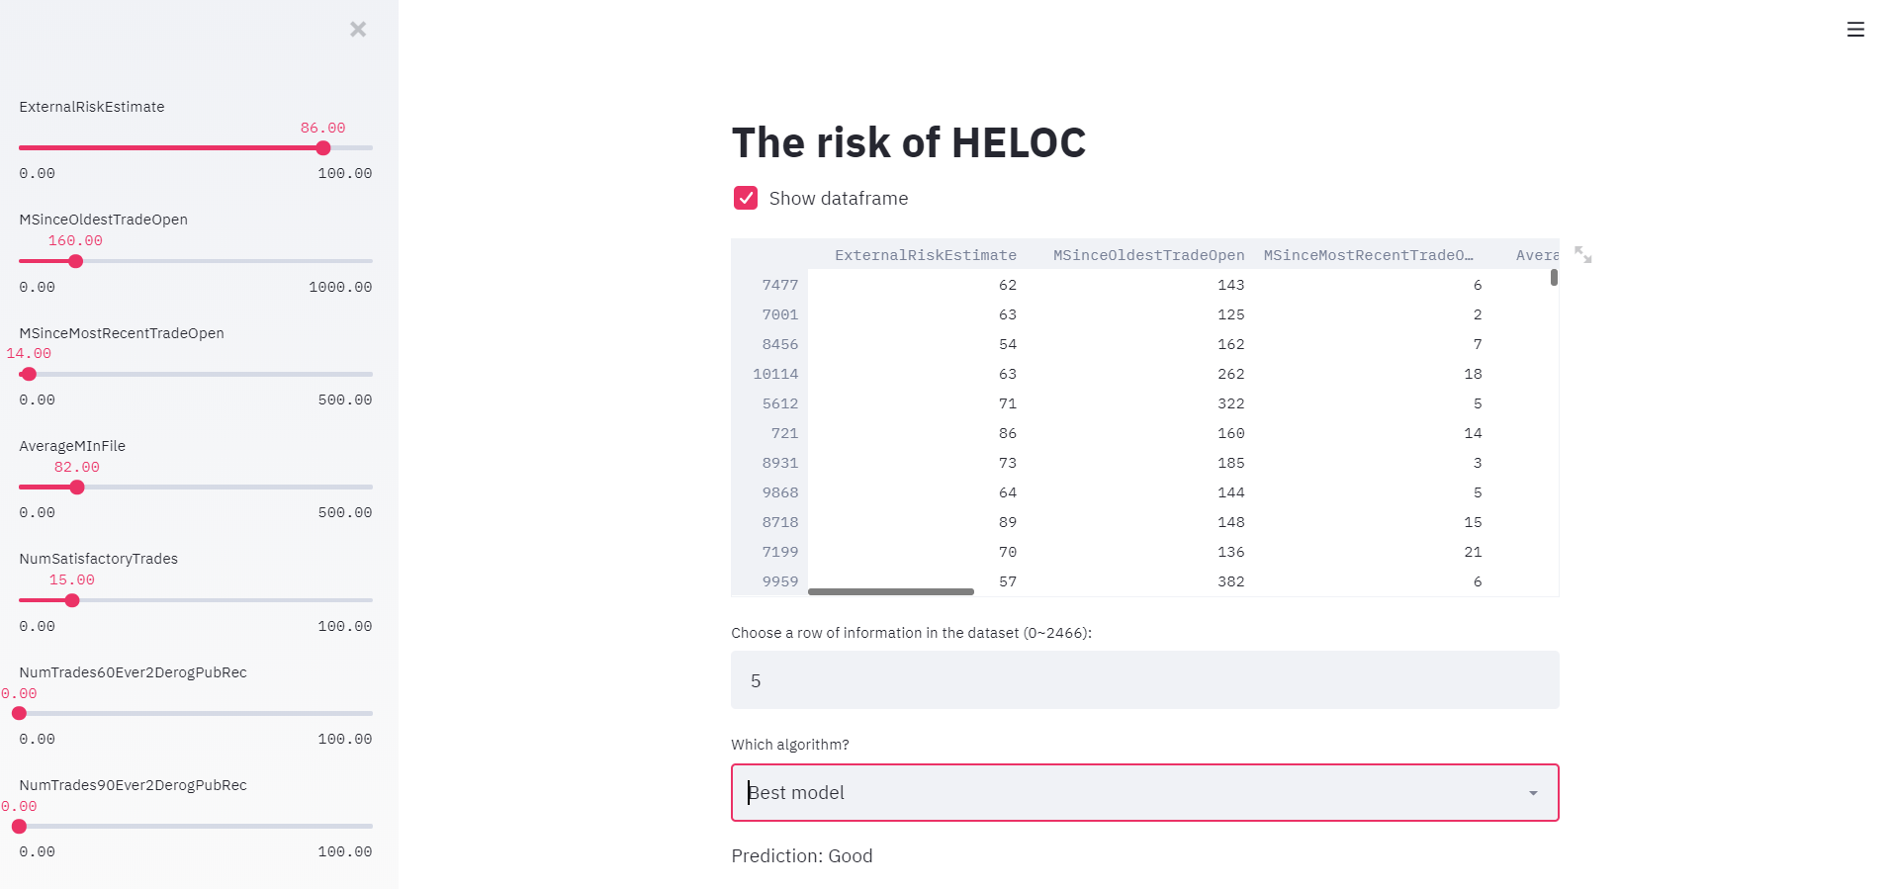
On the center of this interface page, users can input the the number of the row to locate the data and get prediction.Besides, on the left of this page, users can drag the data bar to input specific data in order to get prediction.

Slide 11
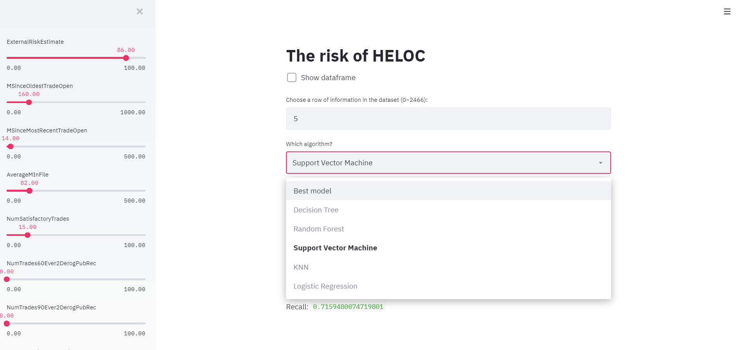
User can choose not only the best model but also other models like decision tree KNN...

Slide 12
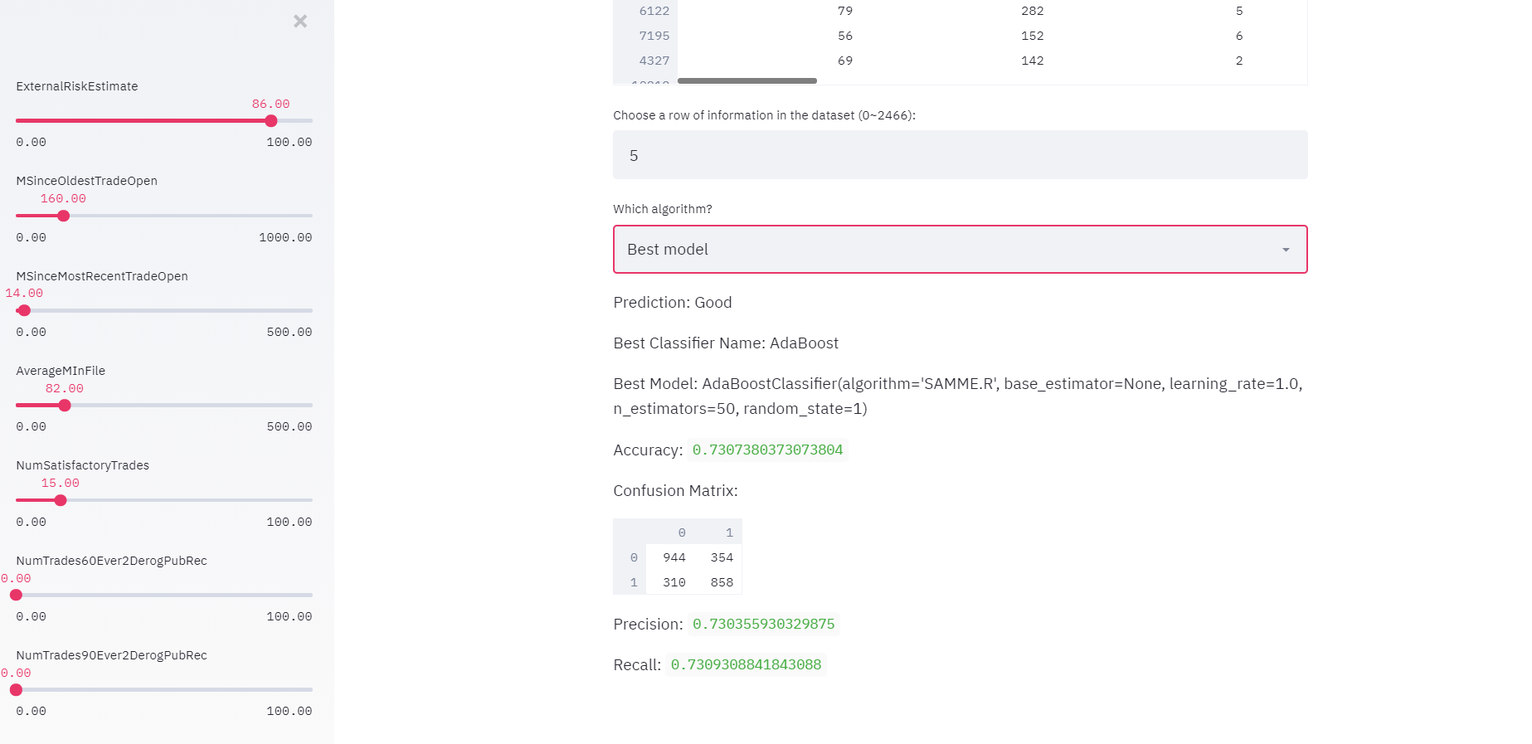
After choose specific model, user can get the result of prediction and also the accuracy, precision and recall as showing above.

Slide 13
4
Recommendation

Slide 14
Recall:
0.728876
Precision:
0.728313
Best Model:
AdaBoost
CV Score:
0.735632
RMSE:
0.520855
Accuracy:
0.728710
End

Slide 15
Thank You!
Team 11

